Slide 1
Multiple Linear Regression
Part 2: Multicollinearity and Residual Analysis

Slide 2
Contents
01
02
Partial Regression Coefficients
R Squared and Adjusted R Squared
03
04
Predicted Values and Residuals
Multicollinearity
05
06
Residual Analysis
Cross Validation

Slide 3

Interpretation of Partial Regression Coefficients
General Interpretation Rule
Practical Example
For every unit increase in the independent variable, the dependent variable (Y) will change by the corresponding parameter estimate, keeping all other variables constant. This is the essence of partial regression coefficients.
From the parameter estimates table, we observe that the parameter estimate for Aptitude Test is 0.3236. This means for one unit increase in aptitude test score, the job performance index will increase by 0.3236 units, holding all other predictors constant.
The "all else constant" qualifier is crucial—it distinguishes multiple regression from simple bivariate correlation.

Slide 4
Measure of Goodness of Fit: R²
Understanding R²
Adjusted R²
R² represents the proportion of variation in the dependent variable that is explained by the independent variables in the model. It ranges from 0 to 1, with higher values indicating better fit.
Adjusted R² is a modified version that accounts for the number of predictors. It penalizes unnecessary complexity and can decrease when irrelevant variables are added.
Important: R² always increases when variables are added to the model, even if those variables don't meaningfully improve predictions.
This makes adjusted R² more appropriate for comparing models with different numbers of predictors.
Formula
Formula
R² = Explained Variation / Total Variation
R²ₐ = 1 - (n - 1)/(n - p - 1) × (1 - R²)
R² = Σ(Ŷᵢ - Ȳ)² / Σ(Yᵢ - Ȳ)²
R² value for the case study is 0.88. Therefore, 88% of the variation in job performance index is explained by the model and 12% is unexplained variation.

Slide 5
Predicted Values and Residuals
Predicted values are calculated using estimated model parameters by substituting values of predictors into the regression equation. Residuals measure the difference between observed and predicted values.
01
02
Estimated Model Equation
Substitute Predictor Values
jpi = -54.28225 + 0.32356 × aptitude + 0.03337 × tol + 1.09547 × technical + 0.53683 × general
For the first employee: aptitude = 43.83, tol = 55.92, technical = 51.82, general = 43.58
03
04
Calculate Prediction
Compute Residual
Predicted jpi = -54.28225 + 0.32356(43.83) + 0.03337(55.92) + 1.09547(51.82) + 0.53683(43.58) = 41.92796
Residual = Observed jpi − Predicted jpi = 45.52 − 41.92796 = 3.59204

Slide 6
Problem of Multicollinearity
Multicollinearity occurs when there is a strong linear relationship among the independent variables in a regression model. This violates the assumption of predictor independence.
Consequences of Multicollinearity
Unstable Parameter Estimates
Poor Out-of-Sample Performance
Parameters of the model become highly unstable as standard errors of their estimates are inflated. Small changes in the data can lead to large changes in coefficient estimates.
The model may appear ideal for a given sample but fails to predict accurately for out-of-sample data. This limits the model's generalizability and practical utility.

Slide 7
Detecting Multicollinearity
Indications of the Problem
High Pairwise Correlations
Contradictory Significance Tests
Examine the correlation matrix of independent variables. Correlations above 0.80 or 0.90 suggest potential multicollinearity between variable pairs.
The overall F-test indicates the model is significant (based on ANOVA), but very few individual t-tests for coefficients are significant. This paradox often signals multicollinearity.
These symptoms indicate the need for formal diagnostic procedures like VIF calculation.

Slide 8
Detecting Multicollinearity using VIF
The Variance Inflation Factor (VIF) quantifies how much the variance of a regression coefficient is inflated due to multicollinearity. Calculate VIF for each predictor by regressing it on all other predictors.
Dependent Variable
Independent Variables
R²
VIF Calculation
X₁
X₂, X₃, X₄
R₁²
1 / (1 − R₁²)
X₂
X₁, X₃, X₄
R₂²
1 / (1 − R₂²)
X₃
X₁, X₂, X₄
R₃²
1 / (1 − R₃²)
X₄
X₁, X₂, X₃
R₄²
1 / (1 − R₄²)
Decision Rule
Any VIF > 5 indicates presence of multicollinearity requiring remedial action. Some researchers use VIF > 10 as the threshold
In the case study, all VIF values are < 5 indicating absence of Multicollinearity..

Slide 9



Multicollinearity: Remedial Measures
Drop Correlated Variables
Remove one of the independent variables that is highly explained by others. Choose based on theory or practical importance rather than statistical criteria alone.
Principal Component Regression
Use Principal Component Regression (PCR) in cases of severe multicollinearity. This technique transforms correlated predictors into uncorrelated components.
Ridge Regression
Apply Ridge Regression, which adds a penalty term to shrink coefficients. This method trades some bias for reduced variance in coefficient estimates.
Important: Dropping a variable may not be advisable if many VIFs are large, as this suggests a systemic problem requiring more sophisticated solutions.

Slide 10
Residual Analysis
Residual analysis is essential for validating regression assumptions and identifying potential problems with model specification. Using the model equation, we predict the dependent variable for all cases, then examine the differences between observed and predicted values.
Key Definition
Residual = Observed Value − Predicted Value
Recommended Residual Analysis Procedures
Plot Residuals vs. Predicted Values
Check Normality of Errors
Examine the scatter plot for patterns. Ideally, residuals should be randomly scattered around zero with constant variance (homoscedasticity).
Use Q-Q plots of residuals for visual assessment and statistical tests (Kolmogorov-Smirnov Test and Shapiro-Wilk Test) for formal evaluation of the normality assumption.

Slide 11
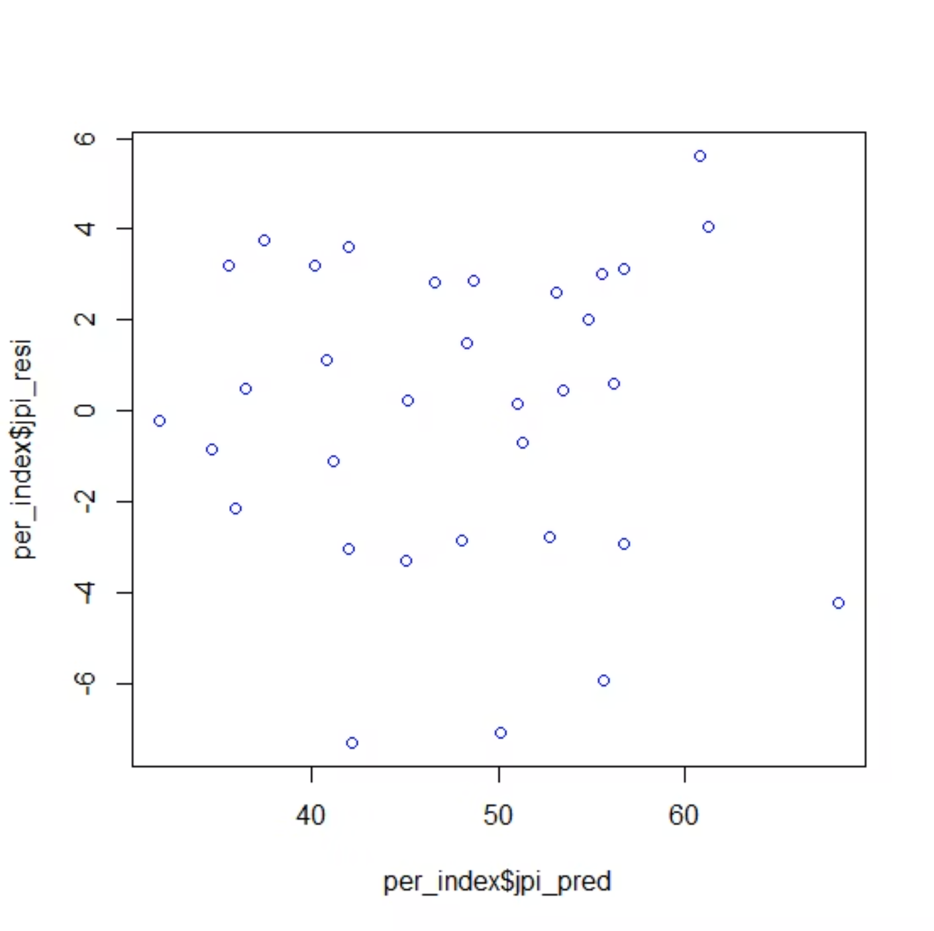
Residuals vs. Predicted Values
Interpreting the Plot
The residual plot displays residuals on the y-axis against predicted values on the x-axis. This diagnostic tool reveals violations of regression assumptions.
Ideal Pattern: Random scatter with no discernible pattern, suggesting the model assumptions are met.
Warning Signs:
Funnel shape indicates heteroscedasticity
Curved pattern suggests non-linearity
Outliers appear as extreme points
Clustering reveals omitted variables
Random pattern of residuals indicates good model fit and satisfied assumptions

Slide 12
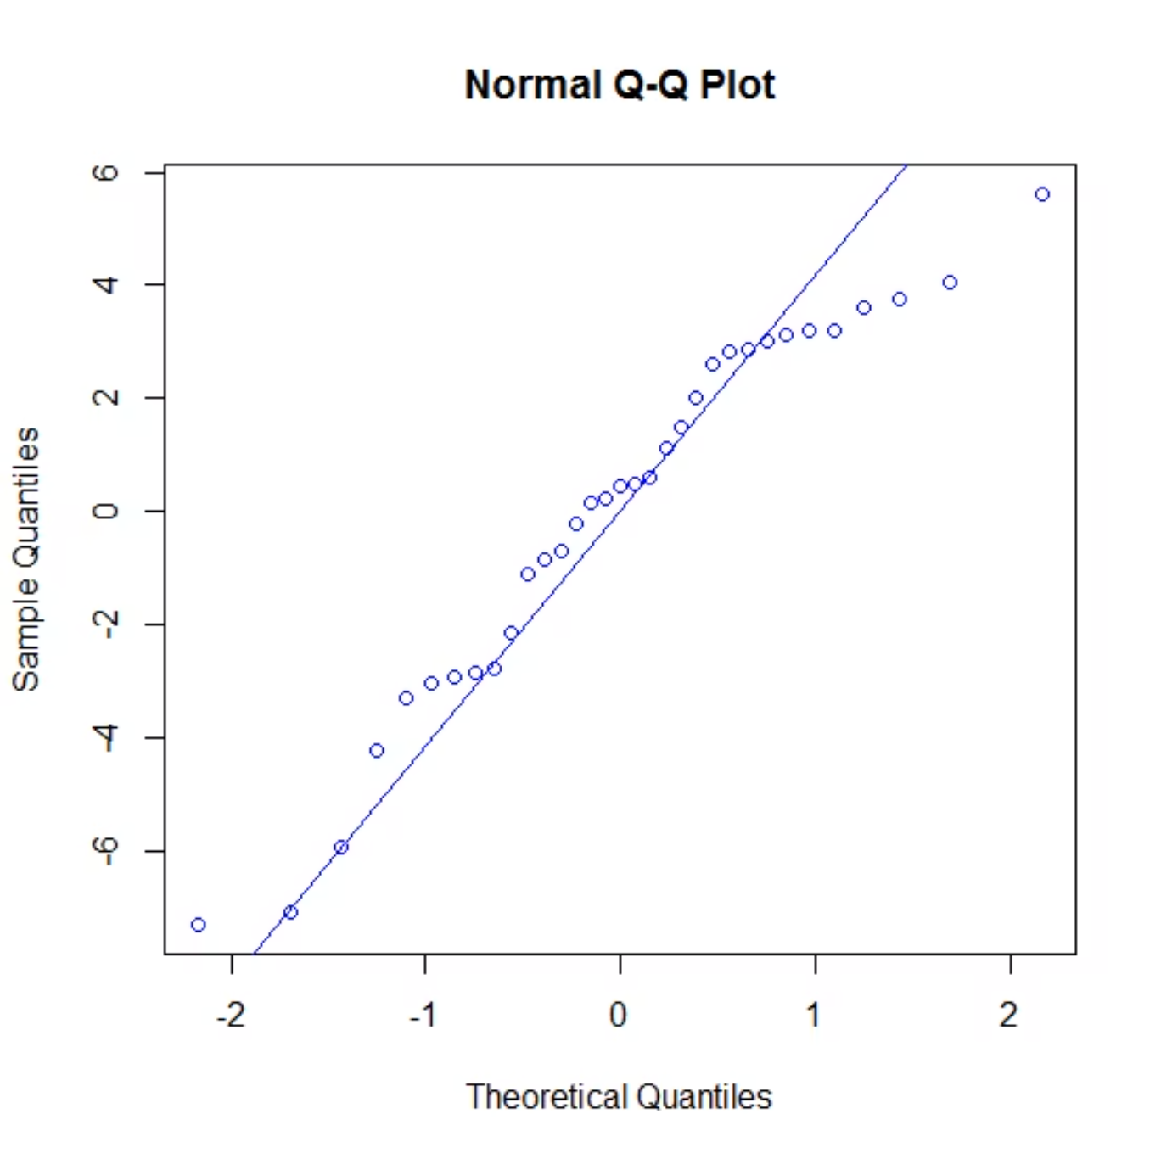
Q-Q Plot and Shapiro-Wilk Test in R
Assessing Normality
The Q-Q (quantile-quantile) plot compares the distribution of residuals to a theoretical normal distribution. Points falling along the diagonal line indicate normality.
Shapiro-Wilk Test
This formal statistical test evaluates the null hypothesis that residuals follow a normal distribution. A p-value > 0.05 suggests we fail to reject normality.
Conclusion: Based on the Q-Q plot and statistical test results, errors can be assumed to follow a Normal distribution.
Q-Q plot shows residuals closely following the diagonal line

Slide 13
Using Categorical Independent Variables
Multiple Linear Regression with Dummy Variables
Categorical variables must be converted into numerical form for regression analysis. This is accomplished using dummy (binary) variables that indicate category membership.
1
2
The K−1 Rule
Example Application
If a categorical independent variable has K categories, we must define only K − 1 dummy variables. The omitted category serves as the reference group.
Dependent Variable: Sales of a restaurant
Independent Variables: Location of restaurant (categorical) and number of households in the area (continuous)
Location has 3 categories: Mall, Street, Highway
We create 2 dummy variables (3 − 1 = 2), with "Highway" serving as the reference category.

Slide 14

Data Snapshot: Dummy Variable Coding
The table demonstrates how categorical variables are encoded for regression analysis. Each row represents one restaurant, with dummy variables indicating location type.
Restaurant
NOH
Location
Sales
Mall
Street
Interpretation
1
155
highway
135.27
0
0
Reference
2
93
highway
72.74
0
0
Reference
7
178
mall
179.86
1
0
Mall coded
8
215
mall
220.14
1
0
Mall coded
13
224
street
203.98
0
1
Street coded
14
199
street
174.48
0
1
Street coded
Variable Definitions: Y = Sales | X₁ = Number of Households | X₂ = 1 if Mall, 0 otherwise | X₃ = 1 if Street, 0 otherwise

Slide 15


Cross-Validation in Predictive Modeling
Cross-validation is a critical process for evaluating model performance on data that wasn't used during model development. This addresses a fundamental problem in predictive modeling: overfitting.
The Overfitting Problem
Out-of-Sample Evaluation
Model performance measures such as R² or Root Mean Squared Error (RMSE) tend to be overly optimistic on in-sample data. Models can memorize training data patterns that don't generalize.
More realistic measures of model performance are calculated using "out-of-sample" data—observations the model has never seen. This provides an honest assessment of predictive accuracy.
Cross-validation is a procedure for assessing model performance using out-of-sample data, providing a more accurate estimate of how the model will perform in practice.

Slide 16
Cross-Validation: Hold-Out Method
The hold-out validation method is the simplest form of cross-validation. It provides a straightforward way to assess how well your model generalizes to new data.
Split the Data
Evaluate Performance
Available data is divided into two non-overlapping parts: training data and testing data. The split is typically 70-80% for training and 20-30% for testing.
The fitted model is evaluated using the testing data, which provides an unbiased assessment of predictive accuracy.
1
2
3
Develop Model
The model is fitted using only the training data. All parameter estimation and model refinement occurs on this subset.
Training Data
Testing Data
Data used to fit the model, estimate parameters, and make decisions about model structure and complexity.
"Fresh" data used exclusively to evaluate model performance. Never used during model development to ensure unbiased assessment.

Slide 17




Key Takeaways
Multiple Linear Regression
Estimation and Hypothesis Testing
Used to model continuous dependent variable.
Independent variables can be continuous or categorical.
Parameter Estimation by Least Square Method.
Hypothesis Testing is performed to assess significance of predictors.
R Squared and Adjusted R Squared
Multicollinearity and Residual Analysis
Measures of goodness of model fit
Independent variables should not be linear dependent on each other. Residual analysis helps to assess model misspecifications.

